Slide 1
MPU and sensors

Slide 2
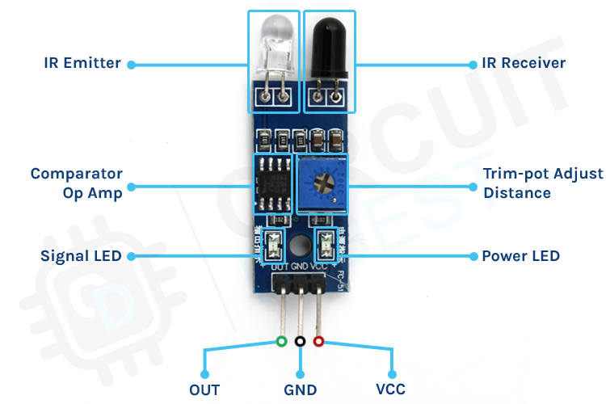
IR Sensor

Slide 3
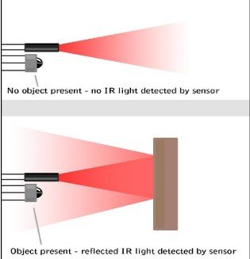
Working of IR sensor

Slide 4
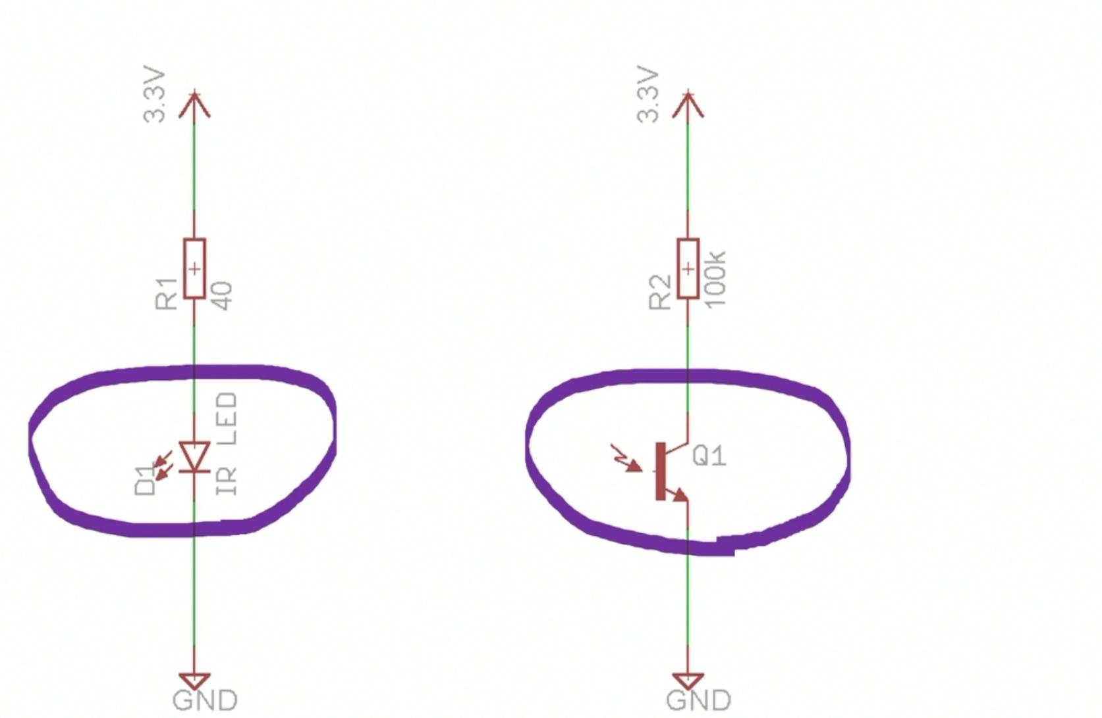

Slide 5
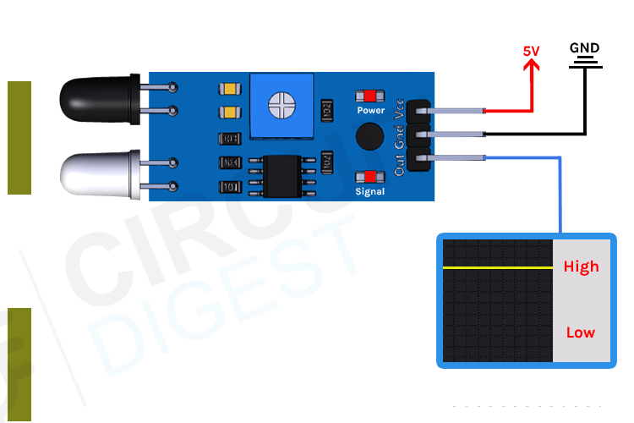

Slide 6
GPS
GPS is a system of 30+ navigation satellites circling Earth.
A GPS receiver in your phone listens for these signals.
Once the receiver calculates its distance from four or more GPS satellites, it can figure out where you are.

Slide 7
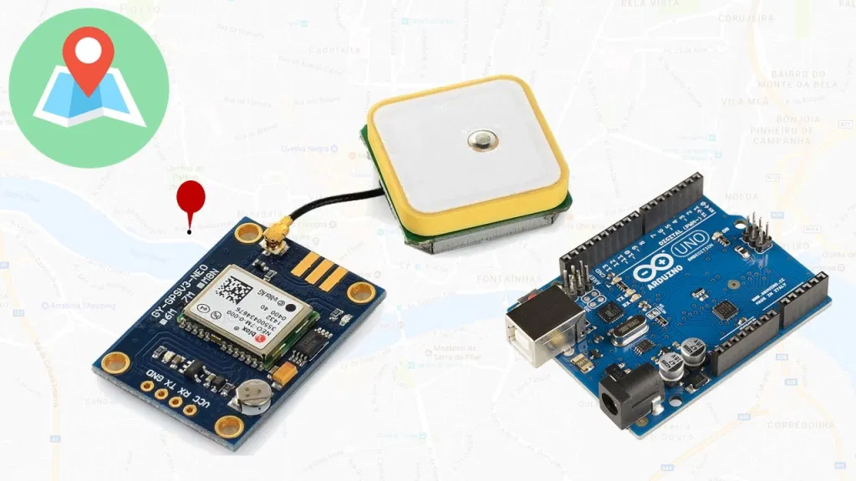

Slide 8
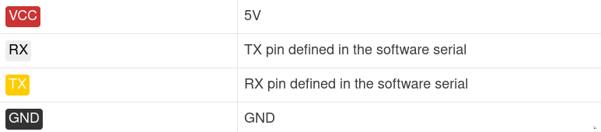

Slide 9
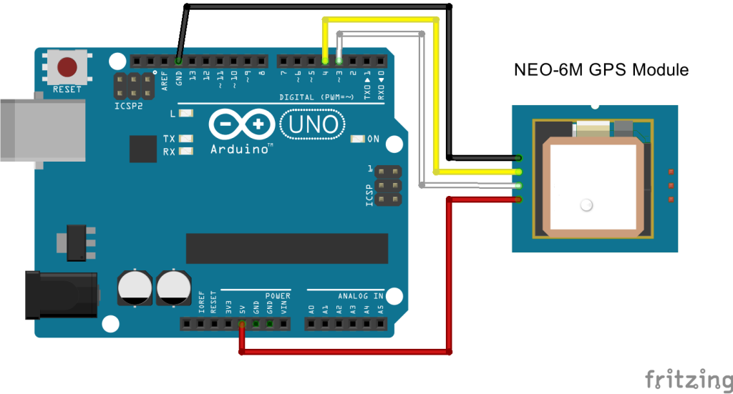

Slide 10
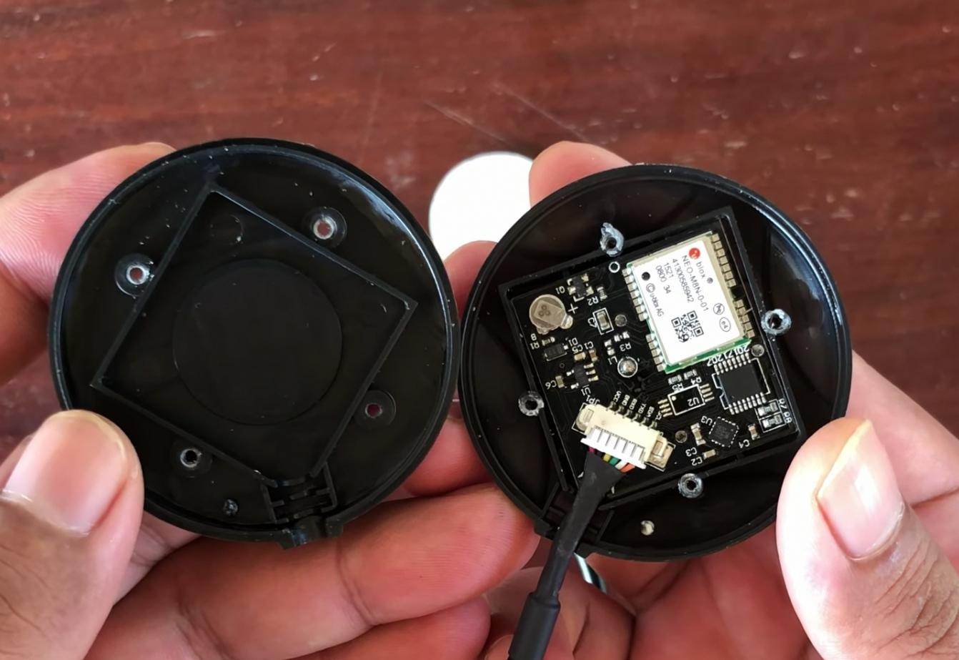

Slide 11
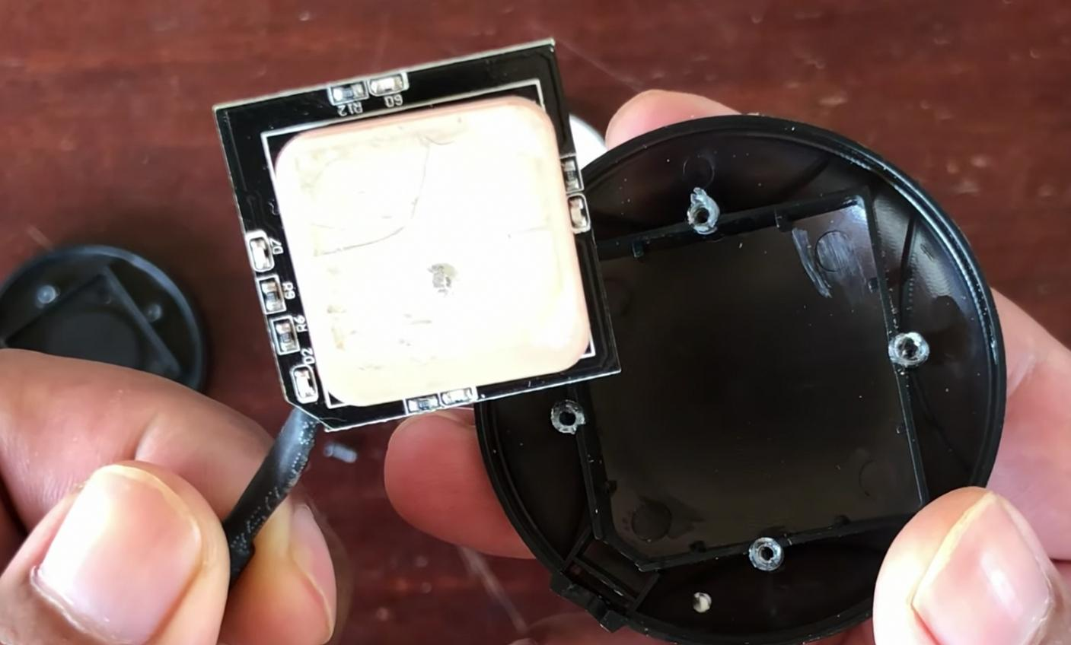

Slide 12
Sample Outputs
$GPGGA,110617.00,41XX.XXXXX,N,00831.54761,W,1,05,2.68,129.0,M,50.1,M,,*42
$GPGSA,A,3,06,09,30,07,23,,,,,,,,4.43,2.68,3.53*02
$GPGSV,3,1,11,02,48,298,24,03,05,101,24,05,17,292,20,06,71,227,30*7C
$GPGSV,3,2,11,07,47,138,33,09,64,044,28,17,01,199,,19,13,214,*7C
$GPGSV,3,3,11,23,29,054,29,29,01,335,,30,29,167,33*4E
$GPGLL,41XX.XXXXX,N,00831.54761,W,110617.00,A,A*70
$GPRMC,110618.00,A,41XX.XXXXX,N,00831.54753,W,0.078,,030118,,,A*6A
$GPVTG,,T,,M,0.043,N,0.080,K,A*2C

Slide 13
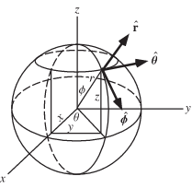

Slide 14
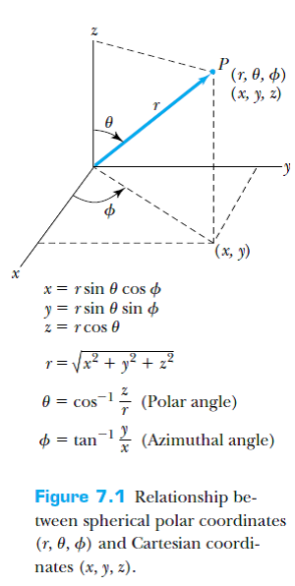

Slide 15
Lidar - Light Detection and Ranging

Slide 16
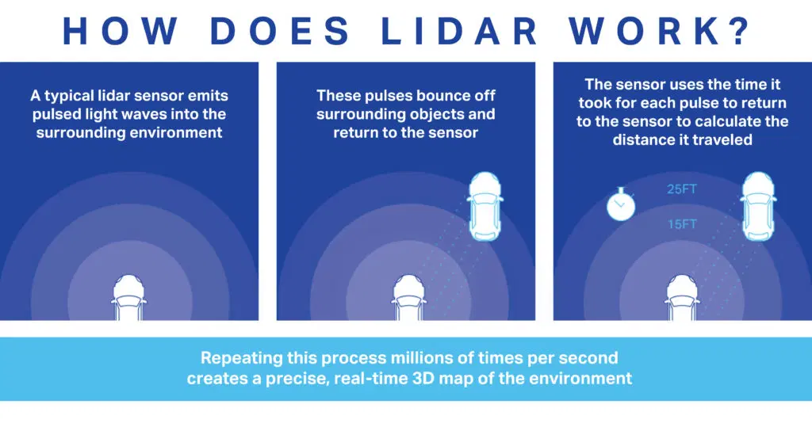

Slide 17
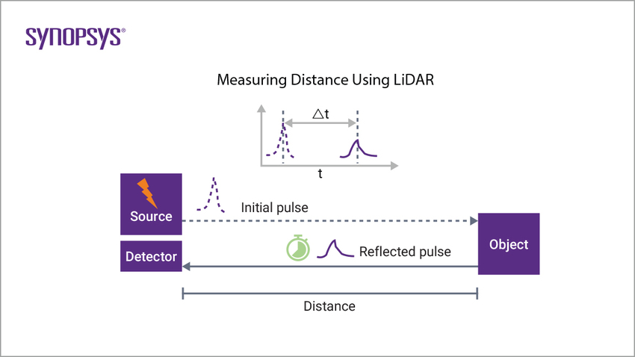

Slide 18
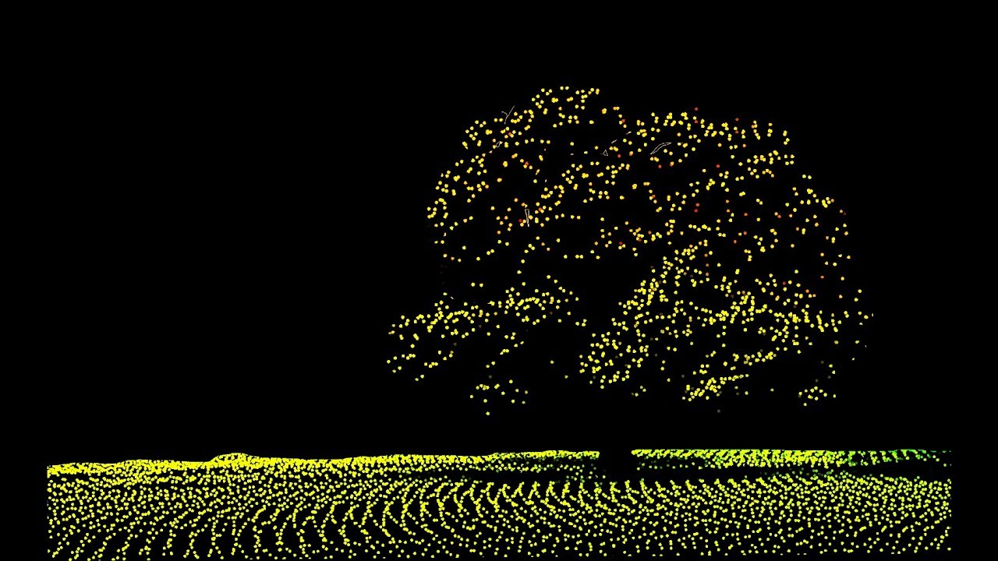

Slide 19
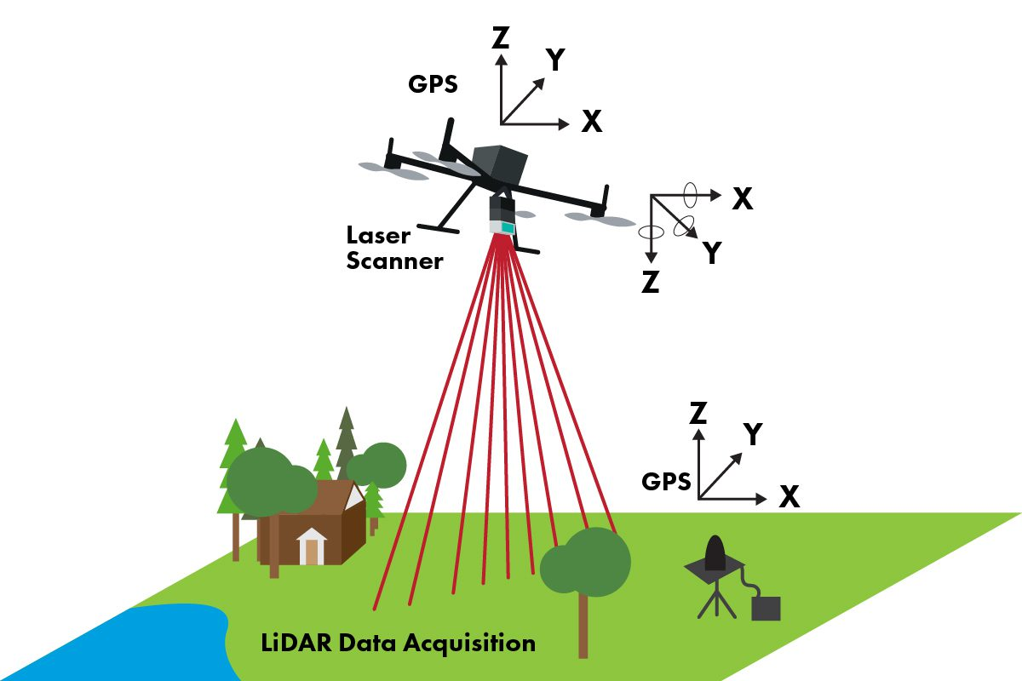

Slide 20
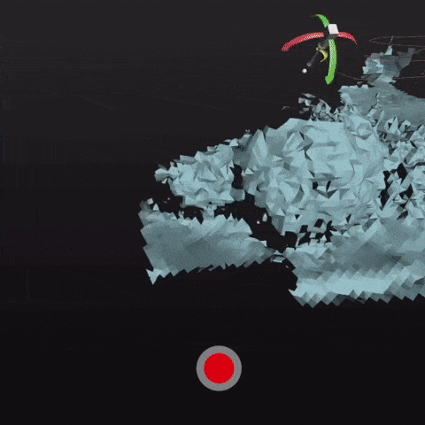

Slide 21
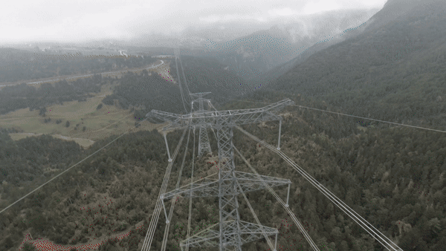

Slide 22
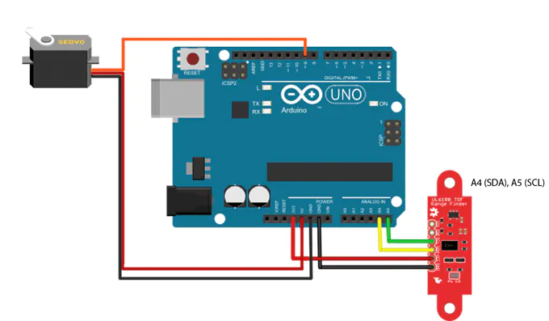

Slide 23
MPU

Slide 24
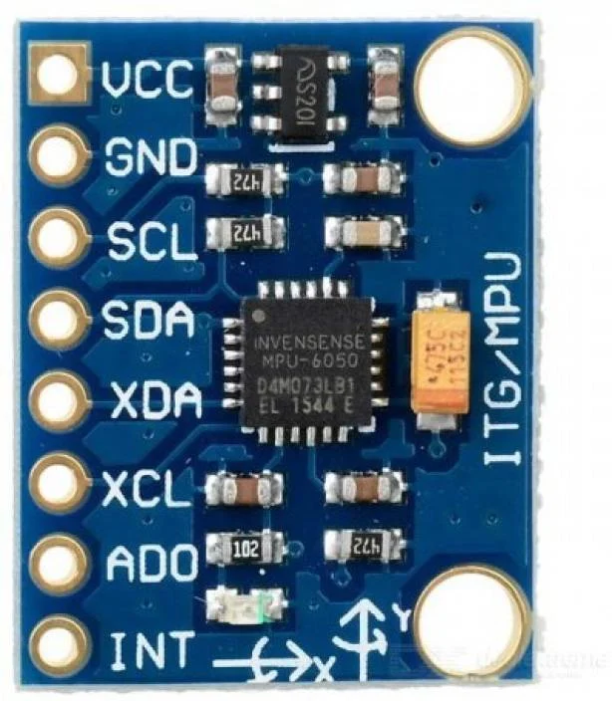

Slide 25
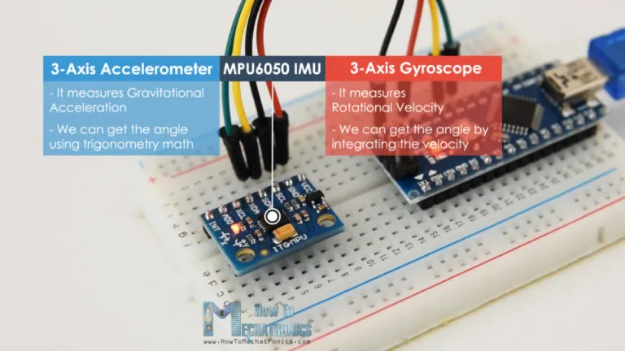

Slide 26
MPU 6050
The MPU6050 IMU has both 3-Axis accelerometer and 3-Axis gyroscope integrated on a single chip.
The gyroscope measures rotational velocity or rate of change of the angular position over time, along the X, Y and Z axis.
The outputs of the gyroscope are in degrees per second, so in order to get the angular position we just need to integrate the angular velocity.

Slide 27
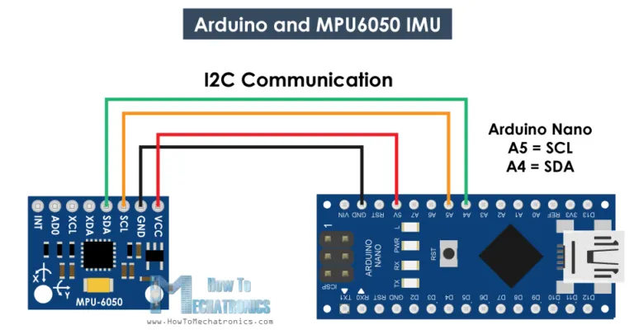

Slide 28
MPU with Arduino
In the setup section, we need initialize the wire library and reset the sensor through the power management register.
In order to do that we need to take a look at the datasheet from where we can see the register address.
we can select the Full-Scale Range for the accelerometer and the gyroscope using their configuration registers.

Slide 29
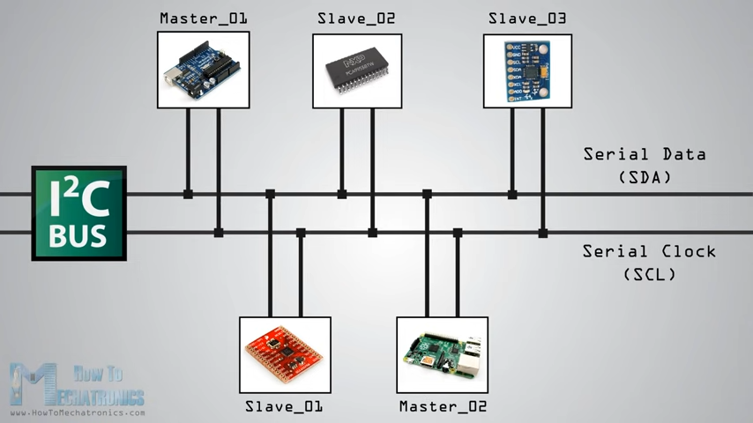

Slide 30
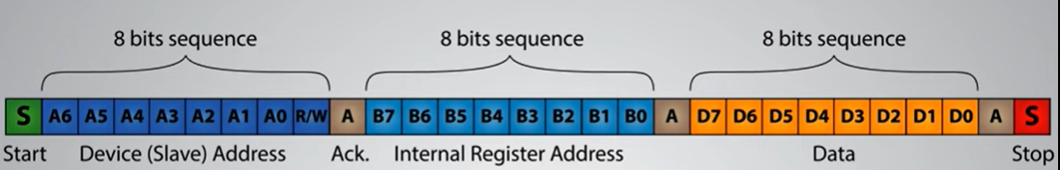
I2C

Slide 31
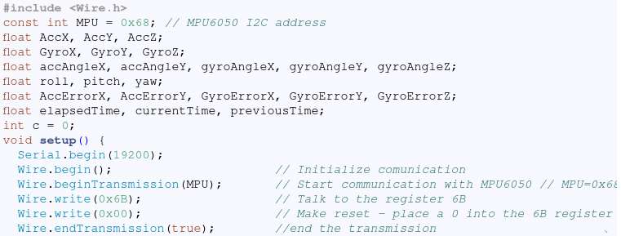

Slide 32
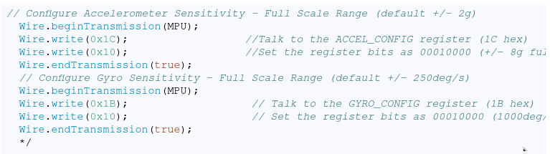

Slide 33
Loop Section
In the loop section we start by reading the accelerometer data.
The data for each axis is stored in two bytes or registers and we can see the addresses of these registers from the datasheet of the sensor.

Slide 34
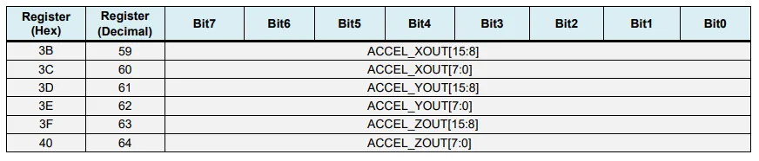

Slide 35
we start with the first register, and using the requiestFrom() function we request to read all 6 registers for the X, Y and Z axes.
Then we read the data from each register
Using these formula, we calculate the roll and pitch angles from the accelerometer data.

Slide 36
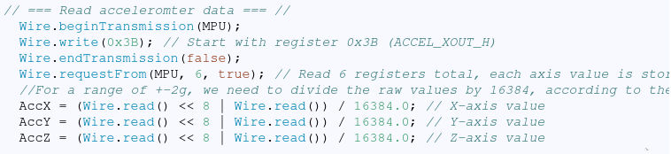

Slide 37
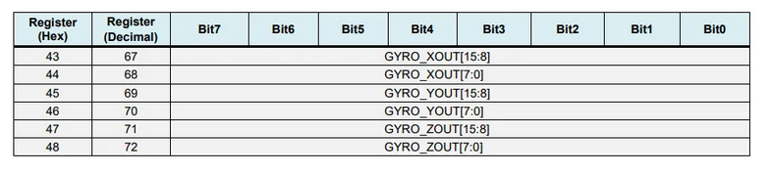
Repeat for Gyroscope

Slide 38
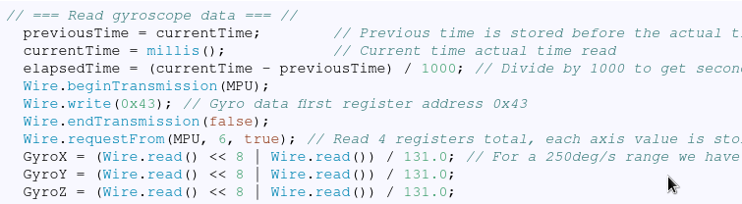

Slide 39
correct the output values with some small calculated error values,
as the outputs are in degrees per second, now we need to multiply them with the time to get just degrees.
The time value is captured before each reading iteration using the millis() function.

Slide 40
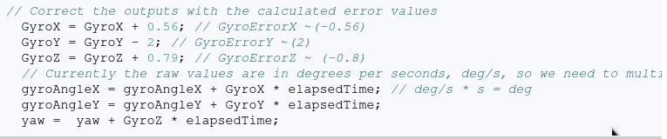

Slide 41
Finally, we fuse the accelerometer and the gyroscope data using a complementary filter.
Here, we take 96% of the gyroscope data because it is very accurate and doesn’t suffer from external forces.
The down side of the gyroscope is that it drifts, or it introduces error in the output as the time goes on.
Therefore, on the long term, we use the data from the accelerometer, 4% in this case, enough to eliminate the gyroscope drift error

Slide 42
we cannot calculate the Yaw from the accelerometer data, we cannot implement the complementary filter on it.

Slide 43
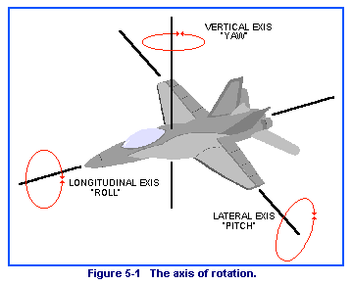
Roll pitch yaw

